Slide 1

SOFTWARE IMPLEMENTATION OF MMWAVE DEMO APPLICATION
PROJECT - PART 2
20AG3FP30 GAURAV PATIDAR
Under the supervision of Professor Sandip Chakraborty

Slide 2


INDEX
TOPICS TO BE DISCUSSED
Problem statement
Solution approach
Tech Stack & Demo
Future Scopes

Slide 3
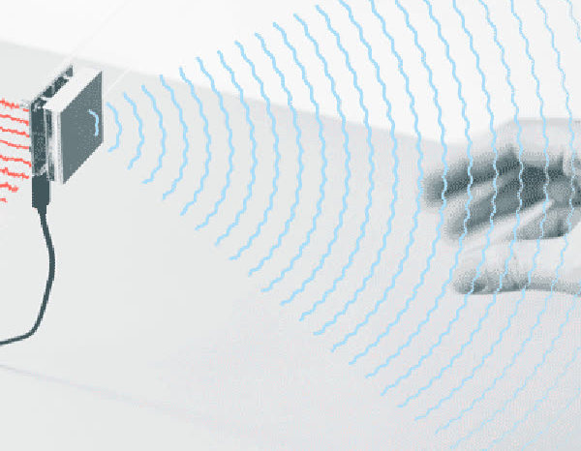
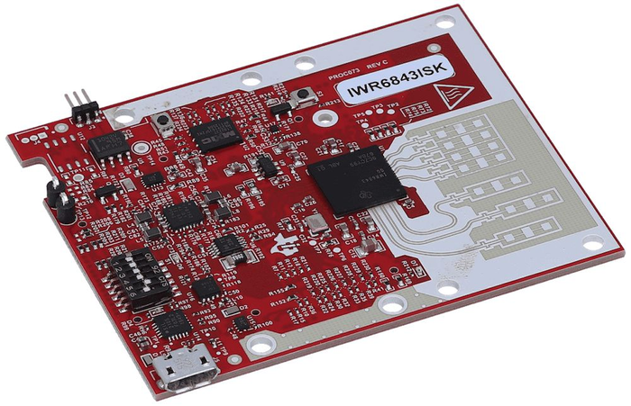
WHY T0 USE MM-WAVE SENSOR AND WHERE
USE EM WAVES
MmWave sensors emit electromagnetic waves with a wavelength in the millimeter range, which allows them to penetrate through some materials and detect change
CAN DETECT VERY SMALL MOVEMENTS
MmWave sensors can detect small movements caused by breathing and heartbeats. This could be used in medical settings for remote patient monitoring, or for fitness tracking
PRIVACY , DON’T USES VISUALS
mmWave sensing can be used to detect human activity through walls and other obstacles, without capturing visual information

Slide 4
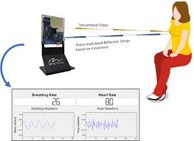
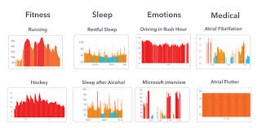
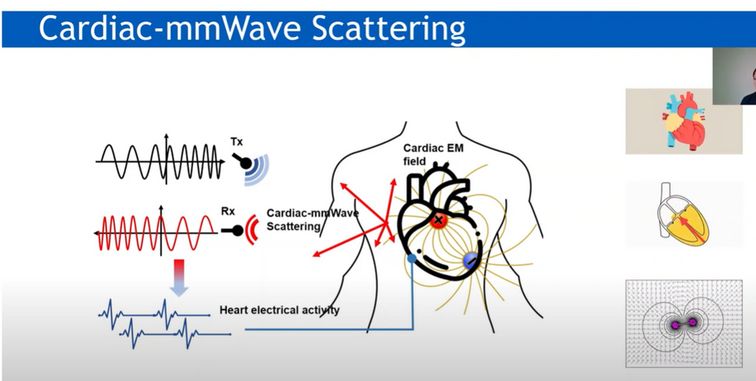
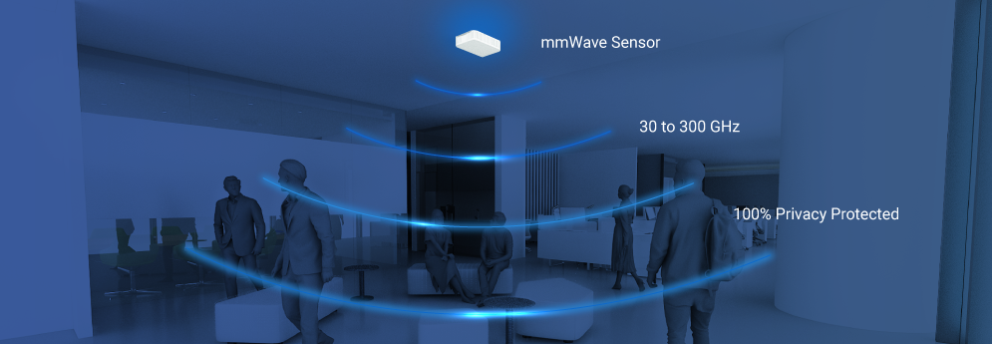
USES

Slide 5

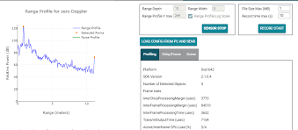
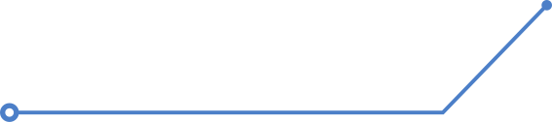
We required a visualizer that can provide real-time data visualization for parameters such as noise, position, etc. and can predict the activity which is in front of it
TI DEMO VISUALISER IS A SOLUTION BUT IT HAVE SOME PROBLEMS
Features are available with a premium subscription
Offering limited flexibility for configuration.
so we developed a In house demo visualizer app that allows users to configure mmWave sensors and visualize point cloud objects generated by the mmWave SDK demo and can classify the activity

Slide 6
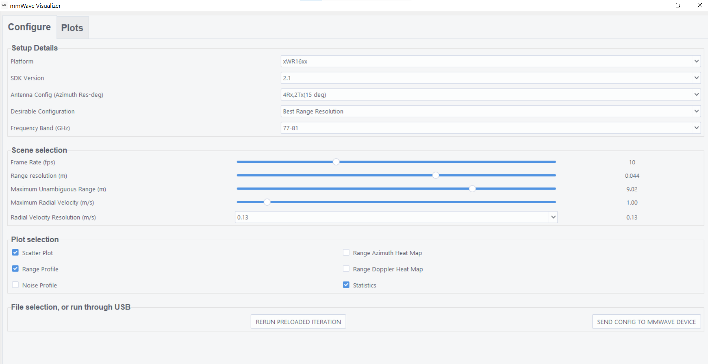
complete demo at the end.....

Slide 7
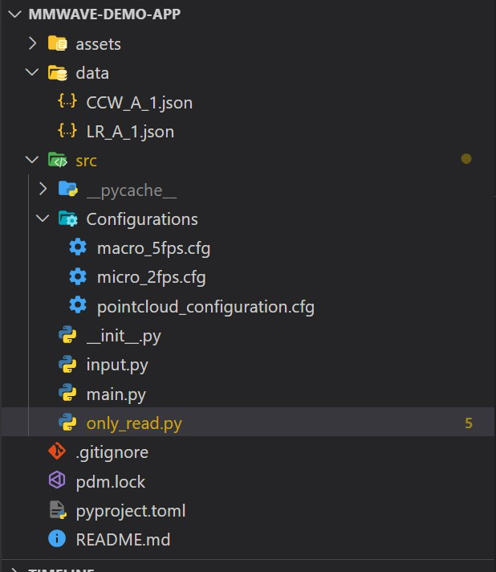
TECH STACK
A QUICK TOUR
We used Python for our project.
The main libraries utilized are:
Tkinter for creating the graphical user interface (GUI).
Threading library for implementing multithreading functionality.
Matplotlib for data visualization.
msgspec for message specification and communication.
google collab to write the model
pkl library to save the model and use it for sensors data for training and applying this trained data to get prediction

Slide 8
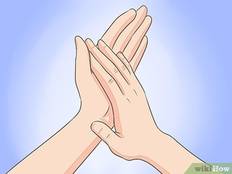



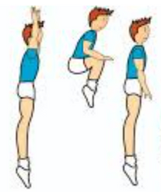
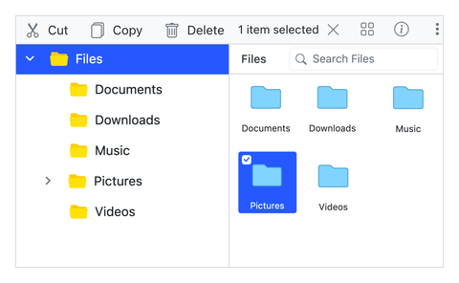
MODEL TRAINING AND PREDICTION
live activity that is to be predicted
training
activites
mmwave
sensor
live data to the
model
model
clap
data is sent to train the model
this particular trained model is saved
prediction
choose model whiich is to be applied
jumping
CLAP

Slide 9
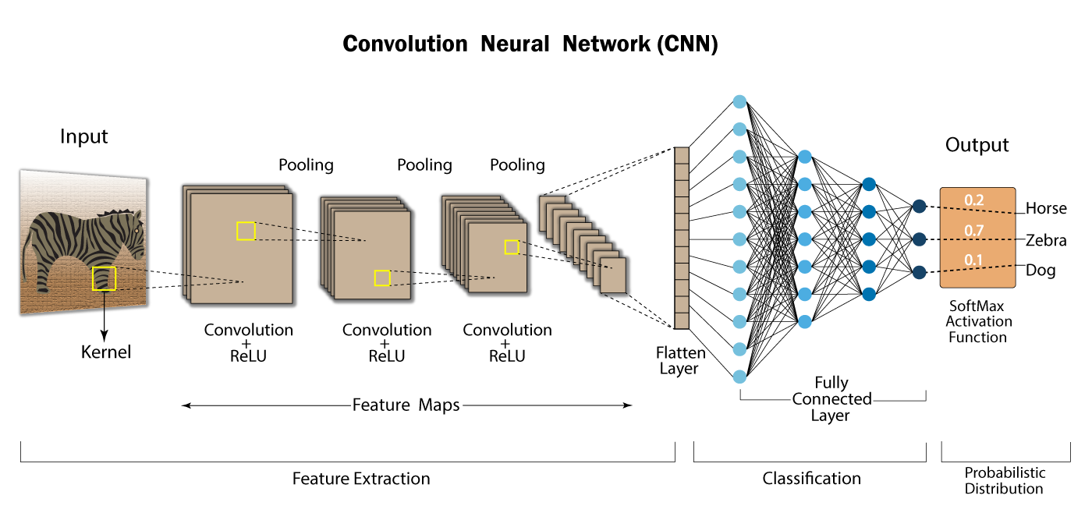
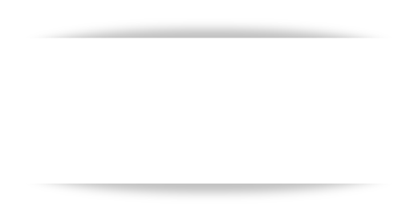
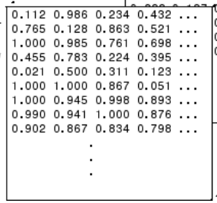

we used CNN for training & prediction
clap
jump
run
range doppler
data

Slide 10
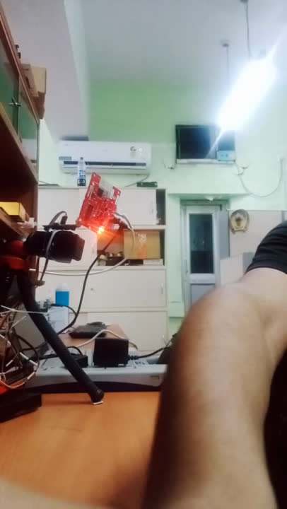

DEMO
live activity is done in front of sensor ,
this activity is done near sensor , next page will show
at this time what is to be done on gui

Slide 11
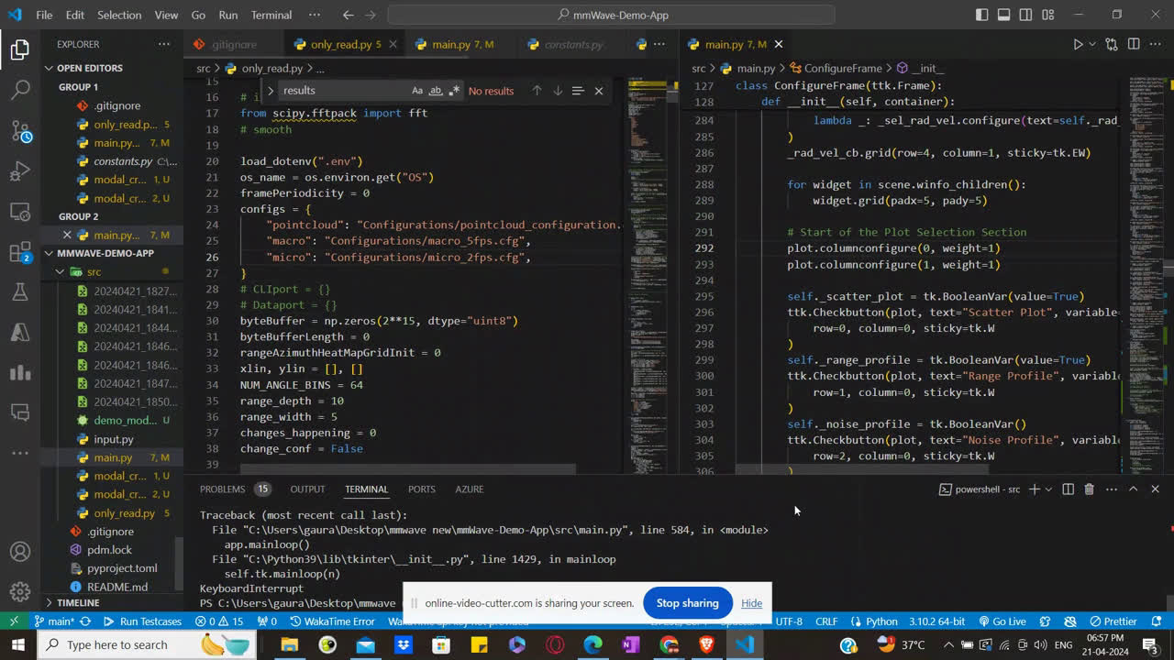

Slide 12

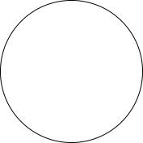

FEATURES
LIVE DATA PLOTTING
CONFIGURABLE APPLICATION
TRAINING &
PREDICTIONS
PUBLISHED AS
OPEN SOURCE

Slide 13
FUTURE SCOPE ?
REAL LIFE TESTING
Model can be trained for different accident-causing activities and alarms can be implemented for violation
PROMOTING IT AS OPEN SOURCE
Promoting the project as open source hence it can be discussed among the code communities and new features can be implemented

Slide 14
BTP PART 2 SOFTWARE IMPLEMENTATION OF MMWAVE DEMO APPLICATION
THANKS
-GAURAV PATIDAR
20AG3FP30

